Slide 1
Message Routing​
Madhu Venkat
Guest Faculty
BITS, WILP

Slide 2
Message Routing
Content-Based Router
Message Filter
Dynamic Router
Recipient List
Splitter
Aggregator
Resequencer
Composed Msg-Processor
Scatter-Gather
Routing Slip

Slide 3
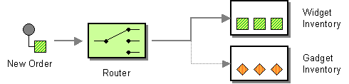
Message Routing
Content-Based Router
The Content-Based Router examines the message content and routes the message onto a different channel based on data contained in the message. The routing can be based on a number of criteria such as existence of fields, specific field values etc.

Slide 4
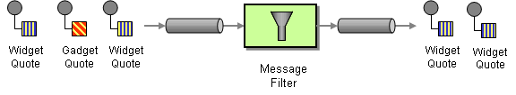
Message Routing
Message Filter
The Message Filter has only a single output channel. If the message content matches the criteria specified by the Message Filter, the message is routed to the output channel. If the message content does not match the criteria, the message is discarded.

Slide 5
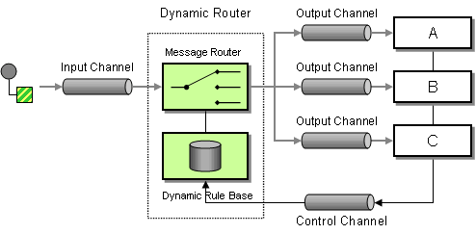
Message Routing
Dynamic Router
Use a Dynamic Router, a Router that can self-configure based on special configuration messages from participating destinations.

Slide 6
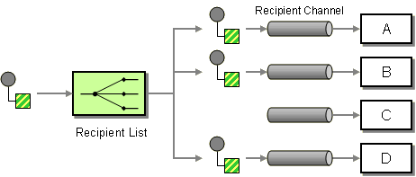
Message Routing
Recipient List
Define a channel for each recipient. Then use a Recipient List to inspect an incoming message, determine the list of desired recipients, and forward the message to all channels associated with the recipients in the list.

Slide 7
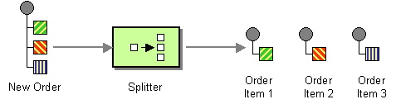
Message Routing
Splitter
Use a Splitter to break out the composite message into a series of individual messages, each containing data related to one item.

Slide 8
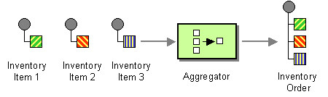
Message Routing
Aggregator
Use a stateful filter, an Aggregator, to collect and store individual messages until a complete set of related messages has been received. Then, the Aggregator publishes a single message distilled from the individual messages.

Slide 9
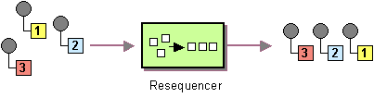
Message Routing
Resequencer
Use a stateful filter, a Resequencer, to collect and re-order messages so that they can be published to the output channel in a specified order.

Slide 10
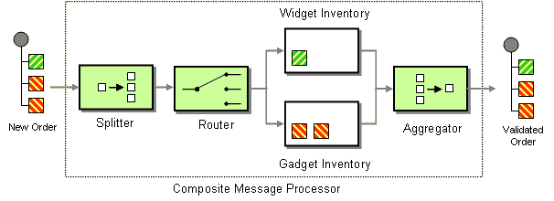
Message Routing
Composed Message Processor
Use Composed Message Processor to process a composite message. The Composed Message Processor splits the message up, routes the sub-messages to the appropriate destinations and re-aggregates the responses back into a single message.

Slide 11
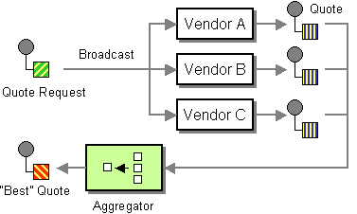
Message Routing
Scatter-Gather
Use a Scatter-Gather that broadcasts a message to multiple recipients and re-aggregates the responses back into a single message.

Slide 12
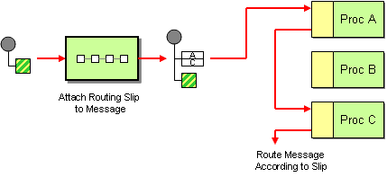
Message Routing
Routing Slip
Attach a Routing Slip to each message, specifying the sequence of processing steps. Wrap each component with a special message router that reads the Routing Slip and routes the message to the next component in the list.

Slide 13
Thank You!
In our next session:
Message Transformation

